Slide 1
DATA 603: Modelling Greenhouse Gas Emissions and Exploring Canadian Energy
Aung Khant Min, Hao Su, Sarah (Sijing) Li, Yi-Chi Chang, Zell Albusairi

Slide 2
Motivation
Energy Efficiency:
Environmental
Economics
Infrastructure
Response Variable: Greenhouse Gas Emissions

Slide 3
Research Question: Can Canada’s GHG emission be modeled based on Canada’s energy consumption and production data?

Slide 4
Objective
Greenhouse gas emission based on the energy production, region, dwelling type, and energy consumption.

Slide 5



Datasets Overview
3 sources of data:
Household energy consumption
Energy production
Greenhouse Gas (GHG) emissions

Slide 6
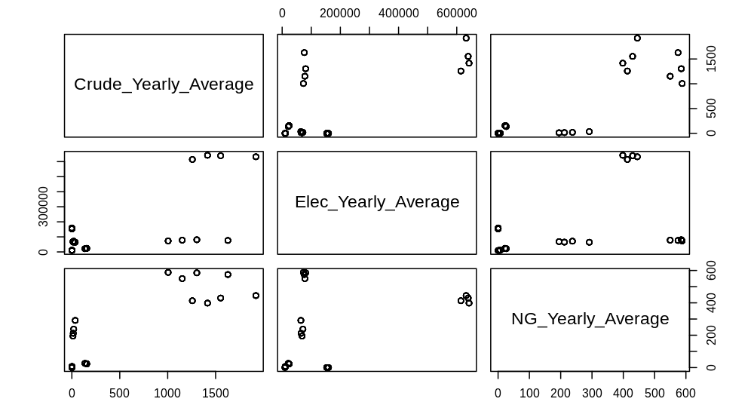
Multicollinearity
Multicollinearity detected:
Region
Yearly production of:
Crude oil
Electricity
Natural gas

Slide 7

Model Building

Slide 8
Base Model Predictors
Stepwise Regression
Backward Regression
All-Possible-Regressions-Selection
Individual t-test
Predictors to keep: Region, Crude_Yearly_Average, Elec_Yearly_Average
Notes:
1. Stepwise Regression:
p-remove higher than p-enter value, while still allowing objective evaluation variables
2. Backward Regression
keep Region, Crude Yearly_Average, and Elec_Yearly_Average
3. All-Possible-Regressions-Selection
We selected the model with three predictors because it minimizes RMSE, Cp and BIC, while maximizing Adjusted R2
4. Individual t-test
p-values for all predictors < α=0.05
5. Consensus:
Keep Region, Crude Yearly_Average, and Elec_Yearly_Average
Next we'll go over interaction terms.

Slide 9
Interaction Terms
Individual t-test from Interaction Terms
Interaction Terms | Significance
factor(Region) * Crude_Yearly_Average | √
factor(Region) * Elec_Yearly_Average | √
Crude_Yearly_Average * Elec_Yearly_Average | √
RMSE | Adjusted $R^{2}$
1129 | 0.9999
Compare to Individual t-test from Base First Order Model
RMSE | Adjusted $R^{2}$
3438 | 0.9998

Slide 10
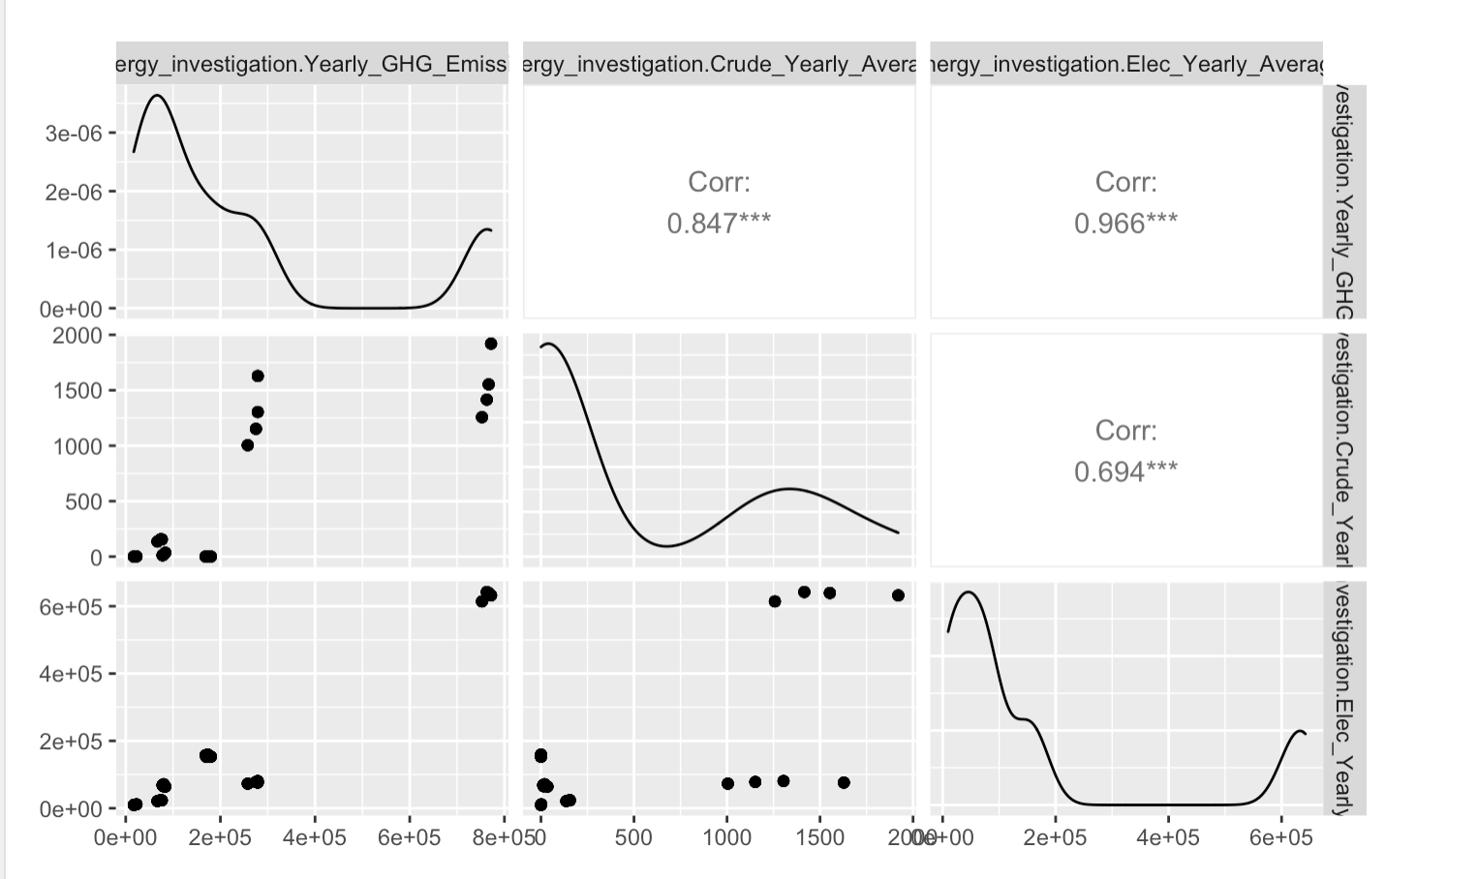
Higher Order
Coefficients | p-value | Significance
Intercept | < 2*10^-16 | ***
factor(Region)BC | < 2*10^-16 | ***
factor(Region)Canada | 0.00000000136 | ***
factor(Region)Nova Scotia | < 2*10^-16 | ***
factor(Region)Ontario | < 2*10^-16 | ***
factor(Region)Saskatchewan | < 2*10^-16 | ***
Crude_Yearly_Average | < 2*10^-16 | ***
Elec_Yearly_Average | 0.0000413 | ***
I(Elec_Yearly_Average^2) | 0.0149 | *
ADJ-R-squared |  | 0.99982
RMSE |  | 3385.032
Notes:
generalized pairs plot

Slide 11
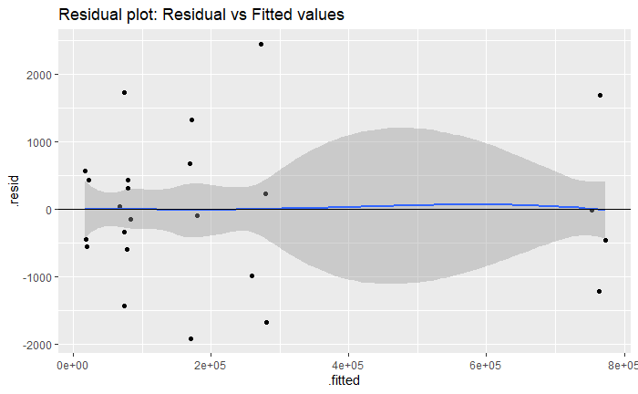
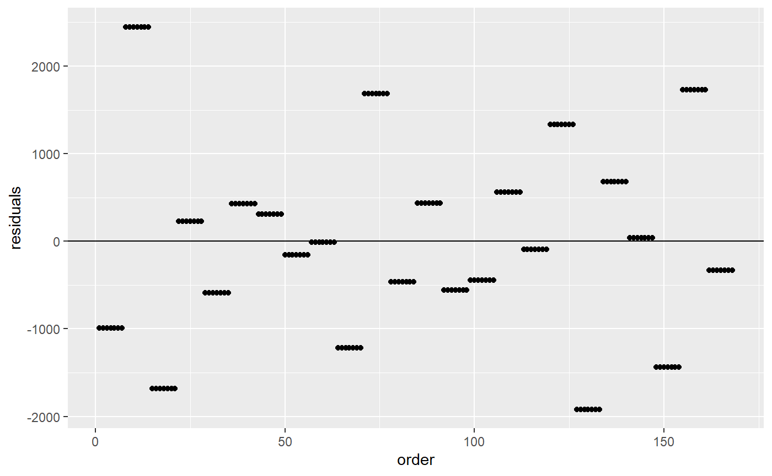
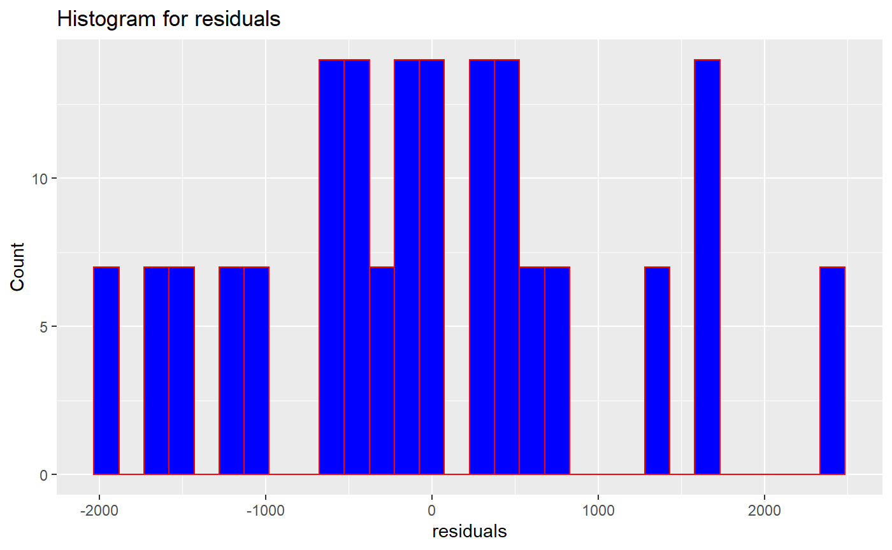
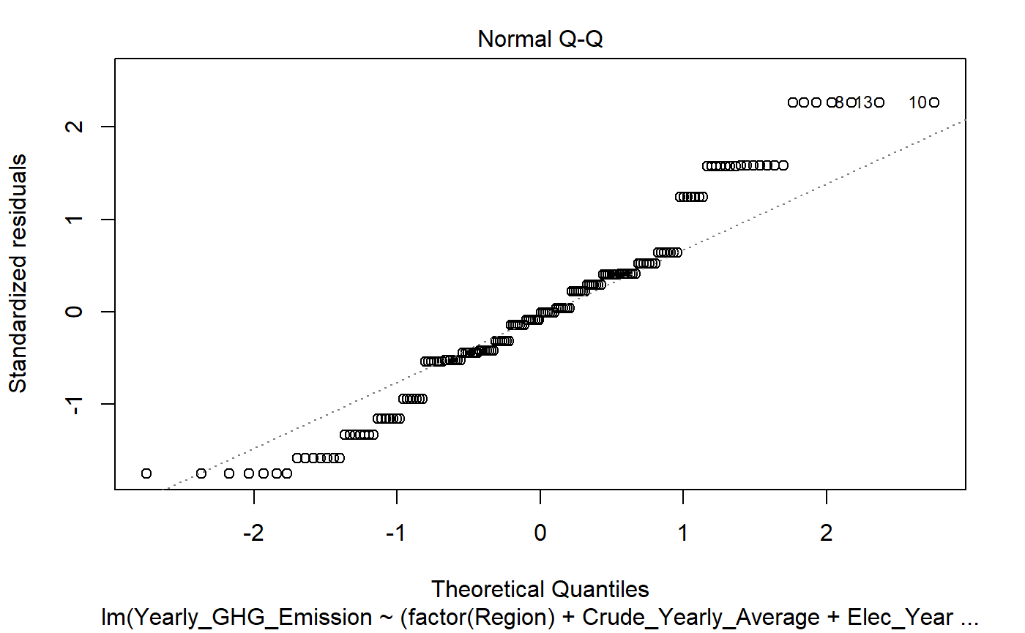


Assumption Checking-1
Linearity | Independence | Homoscedasticity | Normality
No significant non-linear relationship. | Residuals scattered independently. | BP-test: P-value < 0.05 Heteroscedasticity exists. | SW-test: P-value < 0.05 Not normal.

Slide 12
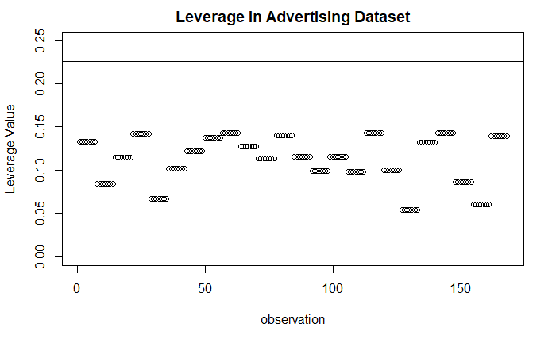
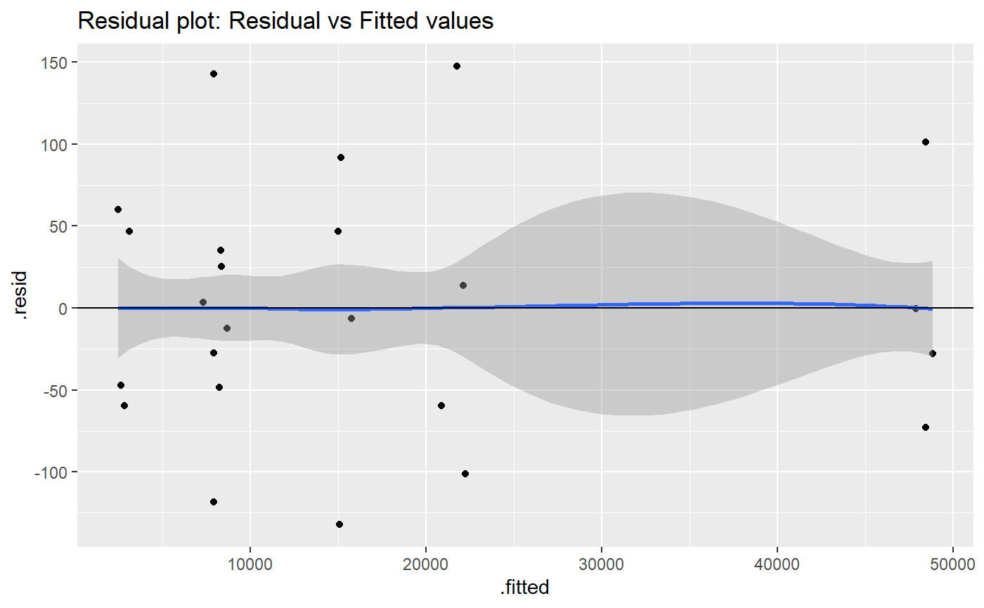
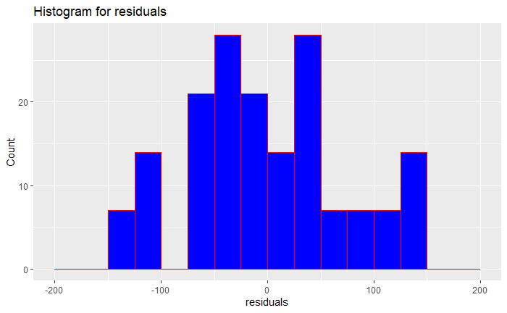
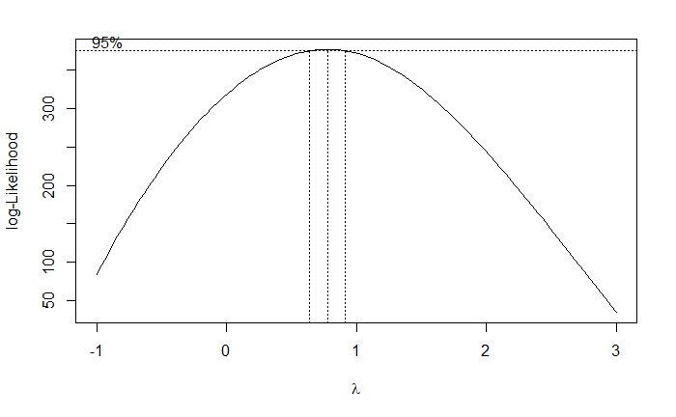
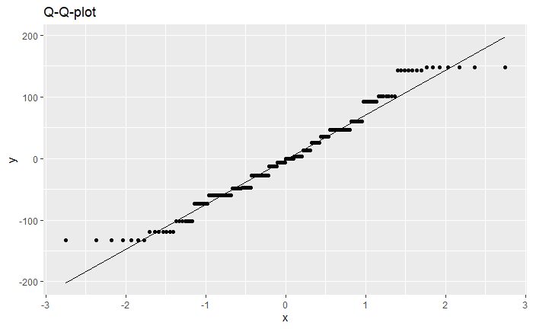
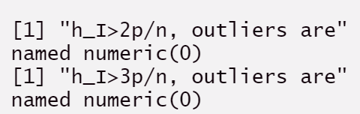
Assumption Checking-2
Outliers | Assumption Fixing: Box-Cox Transformation | Homoscedasticity | Normality
 | Lambda = 0.7778 | Homoscedasticity | Normality
No outliers in the data. |  | BP-test: P-value < 0.05 Heteroscedasticity still exists. | SW-test: P-value < 0.05 Still not normal

Slide 13
Conclusions
 | Intercept | Crude_Yearly_Average | Elec_Yearly_Average | Interaction term: (Crude_Yearly_Average)*(Elec_Yearly_Average)
British Columbia | 77,645.0662 | 306.3824 | -0.0287 | -0.0012
Nova Scotia | -9,829.2871 | 402.6566 | 2.7221 | -0.0012
Ontario | 326,947.2865 | 40,373.4384 | -1.0737 | -0.0012
Saskatchewan | 11,109.4936 | 503.3325 | -0.4286 | -0.0012
Alberta | -19,806.3345 | 114.2416 | 3.4741 | -0.0012
Canada | -471,219.3758 | 794.5800 | 1.9070 | -0.0012

Slide 14
Next Steps
Additional predictors
Additional data
Time Series Modelling
Further improvements on Assumptions

Slide 15
References
Allison, P. (2012, September 10). When Can You Safely Ignore Multicollinearity? Statistical Horizons. https://statisticalhorizons.com/multicollinearity/
Canada Energy Regulator. (2022, July 28). Provincial and Territorial Energy Profiles – Alberta. Canada Energy Regulator. https://www.cer-rec.gc.ca/en/data-analysis/energy-markets/provincial-territorial-energy-profiles/provincial-territorial-energy-profiles-alberta.html#:~:text=About%2089%25%20of%20electricity%20in,and%2054%25%20from%20natural%20gas.
Environmental Protection Agency. (2022). Local Energy Efficiency Benefits and Opportunities. United States Environmental Protection Agency. https://www.epa.gov/statelocalenergy/local-energy-efficiency-benefits-and-opportunities#:~:text=and%20Other%20Sponsors-,Benefits%20of%20Energy%20Efficiency,and%20meet%20growing%20energy%20demand.
Government of Canada. (2022). Greenhouse gas emissions. Government of Canada. https://www.canada.ca/en/environment-climate-change/services/environmental-indicators/greenhouse-gas-emissions.html
Gundersen, G. (2021, July 12). Multicollinearity. https://gregorygundersen.com/blog/2021/07/12/multicollinearity/#:~:text=If%20the%20predictors%20of%20X,predictors%20are%20effectively%20the%20same.
IEA. (2021, November 10). Greenhouse Gas Emissions from Energy Data Explorer. https://www.iea.org/data-and-statistics/data-tools/greenhouse-gas-emissions-from-energy-data-explorer
Lumley, T. (2005, May 11). [R] Regsubsets(). https://stat.ethz.ch/pipermail/r-help/2005-May/071305.html
MacMillan, A., & Turrentine. (2021, April 7). Global Warming 101. https://www.nrdc.org/stories/global-warming-101
Ngamkham, T. (2022a). MLRModelling Part4 Class Notes. Univeristy of Calgary. https://d2l.ucalgary.ca/d2l/le/content/472042/viewContent/5610393/View
Ngamkham, T. (2022b). MLRModellingPart 3-ClassNotes. Univeristy of Calgary. https://d2l.ucalgary.ca/d2l/le/content/472042/viewContent/5601101/View
Ngamkham, T. (2022c). MLRModellingPart1-ClassNotes. Univeristy of Calgary. https://d2l.ucalgary.ca/d2l/le/content/472042/viewContent/5569429/View
Ngamkham, T. (2022d). MLRModellingPart2-ClassNotes. Univeristy of Calgary. https://d2l.ucalgary.ca/d2l/le/content/472042/viewContent/5572726/View
Open Government. (2019). Open Government Licence—Canada. Government of Canada. https://open.canada.ca/en/open-government-licence-canada
Open Government. (2022a). Household energy consumption, Canada and provinces (No. 45fc5597-4ea3-4903-8f9b-405a5468bb0d; Table). Government of Canada. https://open.canada.ca/data/en/dataset/45fc5597-4ea3-4903-8f9b-405a5468bb0d
Open Government. (2022b). Canada’s Energy Future 2021: Energy Supply and Demand Projections to 2050. Government of Canada. https://open.canada.ca/data/en/dataset/5a6abd9d-d343-41ef-a525-7a1efb686300
Pachauri, R. K., Allen, M. R., Barros, V. R., Broome, J., Cramer, W., Christ, R., Church, J. A., Clarke, L., Dahe, Q., Dasgupta, P., Dubash, N. K., Edenhofer, O., Elgizouli, I., Field, C. B., Forster, P., Friedlingstein, P., Fuglestvedt, J., Gomez-Echeverri, L., Hallegatte, S., … Ypersele, J.-P. van. (2015). Climate Change 2014 Synthesis Report (Fifth Assessment Report of the Intergovernmental Panel on Climate Change). https://www.ipcc.ch/site/assets/uploads/2018/02/SYR_AR5_FINAL_full.pdf
Placidia. (2012, November 25). Regsubsets with leaps fails. StackExchange. https://stats.stackexchange.com/questions/44358/regsubsets-with-leaps-fails
ProgrammingR. (2022). How to Fix the R Error: Missing value where true/false needed. ProgrammingR. https://www.programmingr.com/r-error-messages/r-error-missing-value-where-true-false-needed/
Statistics Canada. (2021a). Canadian System of Environmental–Economic Accounts: Energy use and greenhouse gas emissions, 2019. Government of Canada. https://www150.statcan.gc.ca/n1/daily-quotidien/211213/dq211213c-eng.htm
Statistics Canada. (2021b). Physical flow account for greenhouse gas emissions (https://doi.org/10.25318/3810009701-eng). Government of Canada. https://www150.statcan.gc.ca/t1/tbl1/en/tv.action?pid=3810009701&cubeTimeFrame.startYear=2009&cubeTimeFrame.endYear=2019&referencePeriods=20090101%2C20190101
United Nations. (n.d.). The Paris Agreement. United Nations. Retrieved November 7, 2022, from https://www.un.org/en/climatechange/paris-agreement
Zach. (2021, October 21). How to Fix in R: there are aliased coefficients in the model. Statology. https://www.statology.org/r-aliased-coefficients-in-the-model/

Slide 16

Thank you for listening! Questions or Concerns?

Slide 17

Appendix 1: Finalized Model
$$\hat{Yearly_GHG_Emission}=−19806.3345+97451.4007Region_{i1}−451413.0413Region_{i2}+9977.0474Region_{i3}+346753.6210Region_{i4}+30915.8281Region_{i5}+114.2416\text{Crude}\text{_}\text{Yearly}\text{_}\text{Average}+3.4741\text{Elec}\text{_}\text{Yearly}\text{_}\text{Average}+192.1408(Region_{i1})(\text{Crude}\text{_}\text{Yearly}\text{_}\text{Average}\text{)}+680.3384(Region_{i2})(\text{Crude}\text{_}\text{Yearly}\text{_}\text{Average}\text{)}+288.4150(Region_{i3})(\text{Crude}\text{_}\text{Yearly}\text{_}\text{Average}\text{)}+40259.1968(Region_{i4})(\text{Crude}\text{_}\text{Yearly}\text{_}\text{Average}\text{)}+389.0909(Region_{i5})(\text{Crude}\text{_}\text{Yearly}\text{_}\text{Average}\text{)}−3.5028(Region_{i1})(\text{Elec}\text{_}\text{Yearly}\text{_}\text{Average}\text{)}−1.5671(Region_{i2})(\text{Elec}\text{_}\text{Yearly}\text{_}\text{Average}\text{)}−0.7520(Region_{i3})(\text{Elec}\text{_}\text{Yearly}\text{_}\text{Average}\text{)}−4.5478(Region_{i4})(\text{Elec}\text{_}\text{Yearly}\text{_}\text{Average}\text{)}−3.9027(Region_{i5})(\text{Elec}\text{_}\text{Yearly}\text{_}\text{Average}\text{)}−0.0012(\text{Crude}\text{_}\text{Yearly}\text{_}\text{Average})(\text{Elec}\text{_}\text{Yearly}\text{_}\text{Average}\text{)}$$

